Slide 1

Module 4
Advanced Multiple Linear Regression (MLR)
Notes:
Guidelines
Use section headers to chunk content in your presentation.
Use the same style of section header throughout your presentation.
Keep your title to no more than 2 lines.

Slide 2
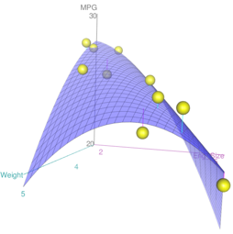

Polynomial Models
Notes:
Guidelines
Use a title slide at the beginning of your presentation. There are 9 variations of title slides to choose from.
If you will have a series of slideshows, we recommend using the same style of title slide for each presentation.
Keep your title to no more than 2 lines.
Do not change the font style or font size of the title or subtitle.

Slide 3
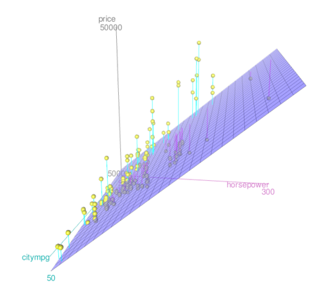
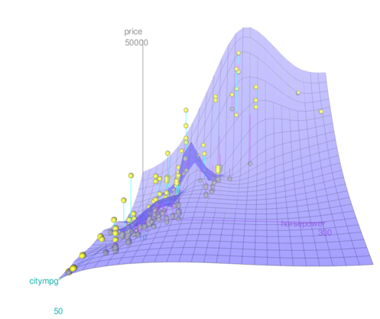
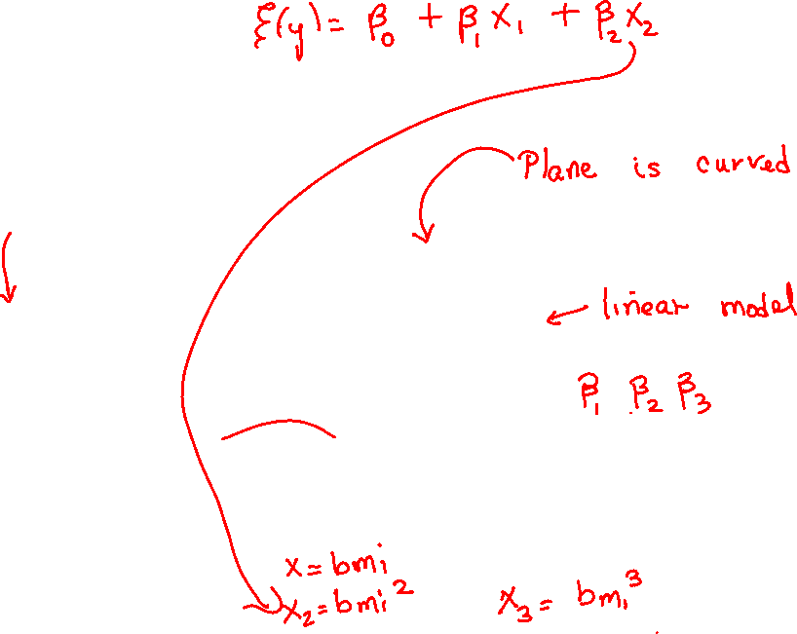
Polynomial Models
Used to model non-linear relationships.

Slide 4
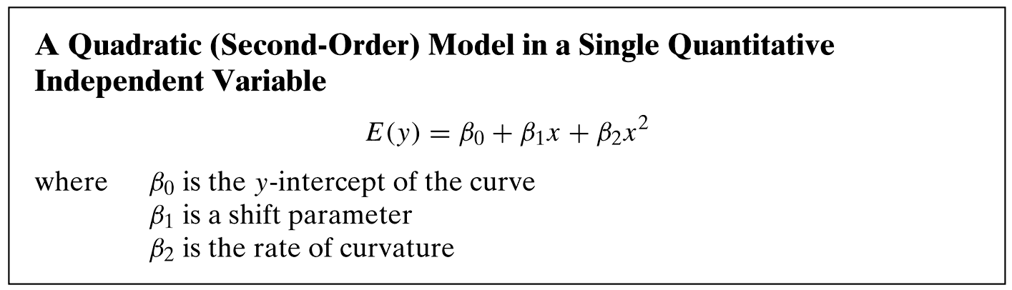
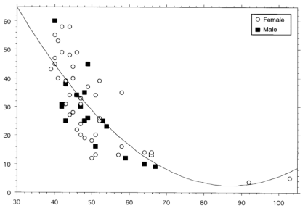

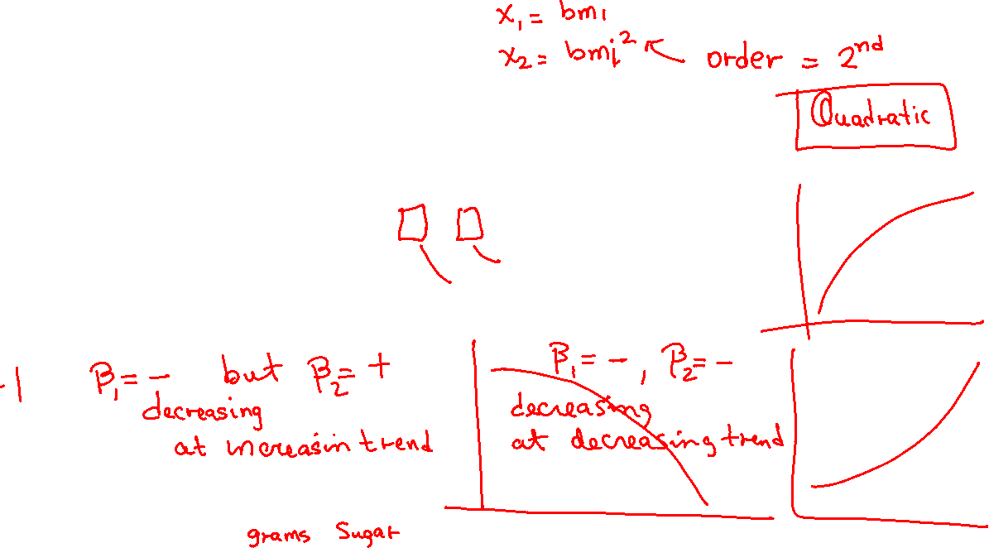
Quadratic Model

Slide 5
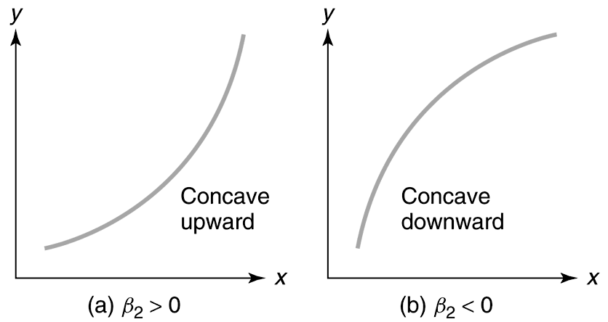
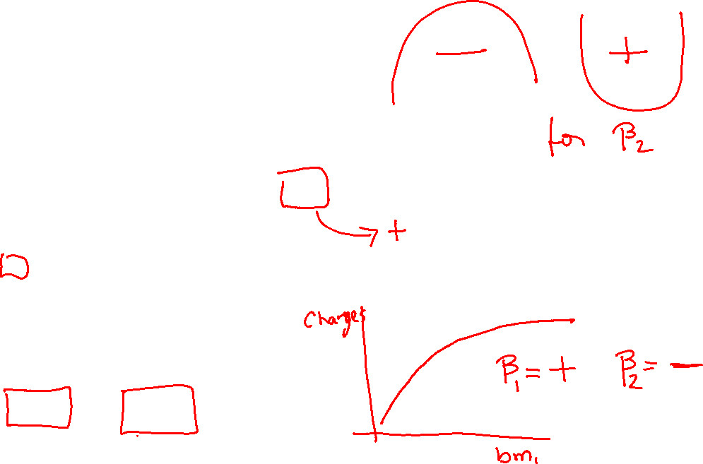
Quadratic Models

Slide 6
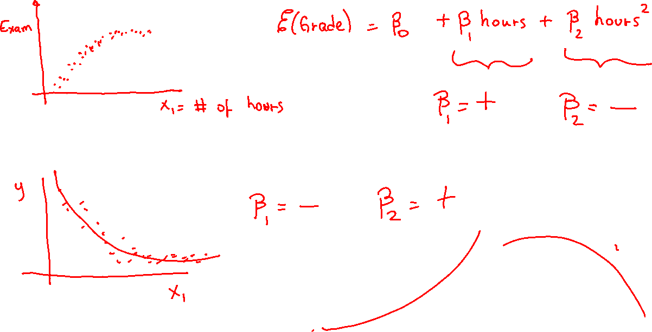

Slide 8
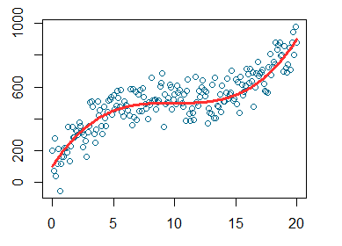
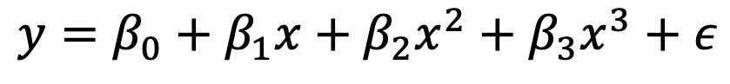
3rd Order Models
We can use higher-order terms depending on the data.
$$y=β_{0}+β_{1}x+β_{2}x^{2}+β_{3}x^{3}+ε$$

Slide 9
Polynomial Regression
Fitting the regression with higher-order terms

Slide 10
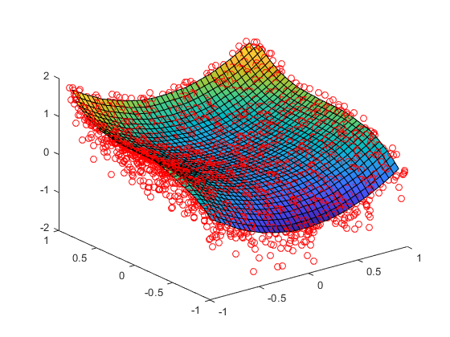
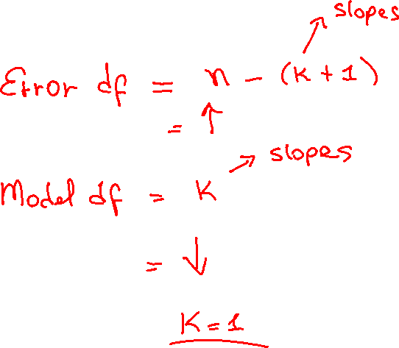
Polynomial Regression
Fitting the regression with higher-order terms

Slide 11
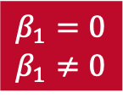

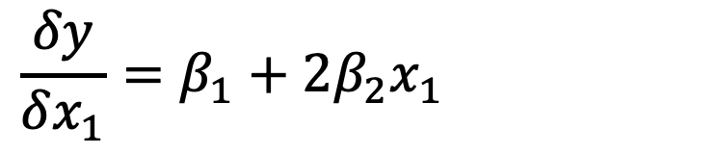
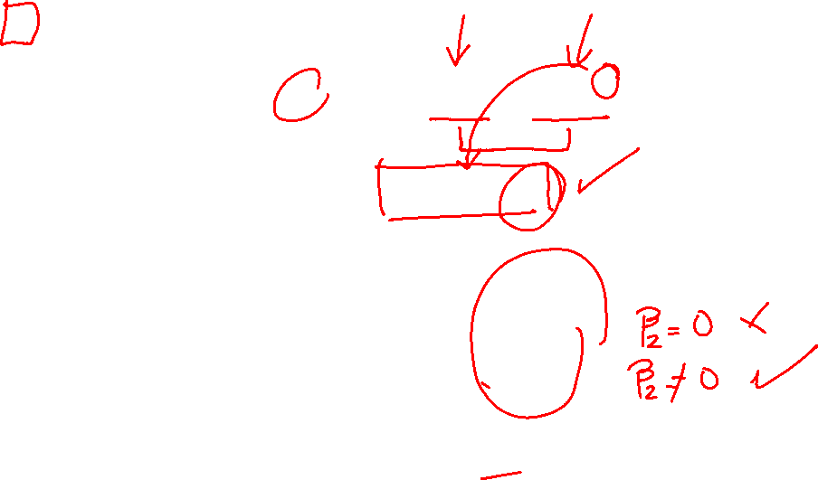
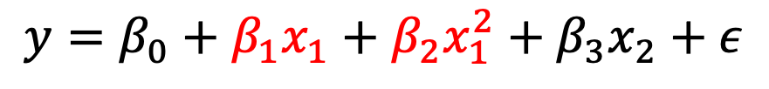

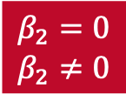
The Effect of Variable $x$ on the Response
How does $y$ change as $x$ changes
$$y=β_{0}+β_{1}x_{1}+β_{2}x_{1}^{2}+β_{3}x_{2}+ε$$
$$\frac{δy}{δx_{1}}=β_{1}+2β_{2}x_{1}$$
Hypothesis Test
Hypothesis Test
$$β_{1}=0$$
$$β_{1}≠0$$
$$β_{2}=0$$
$$β_{2}≠0$$

Slide 12
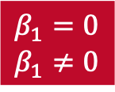
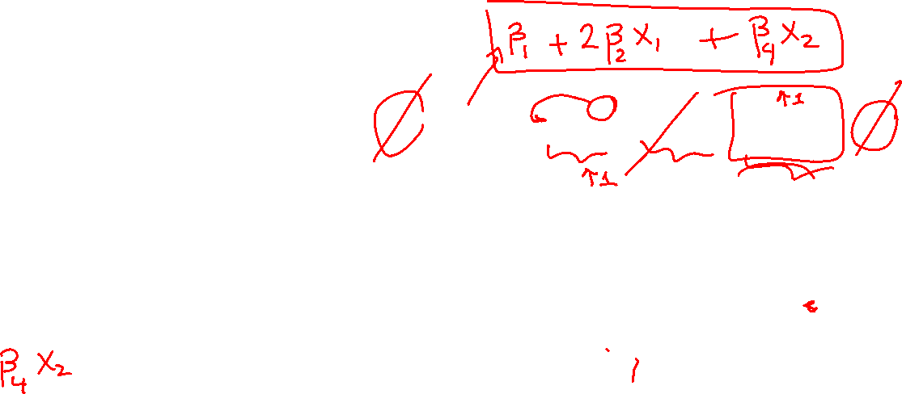
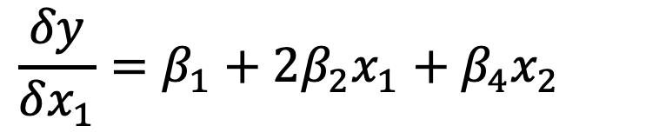
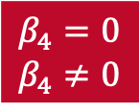
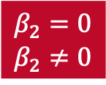
The Effect of Variable $x$ on the Response
How does $y$ change as $x$ changes
$$y=β_{0}+β_{1}x_{1}+β_{2}x_{1}^{2}+β_{3}x_{2}+β_{4}x_{1}x_{2}+ε$$
$$\frac{δy}{δx_{1}}=β_{1}+2β_{2}x_{1}+β_{4}x_{2}$$
Hypothesis Test
Hypothesis Test
Hypothesis Test
$$β_{1}=0$$
$$β_{1}≠0$$
$$β_{2}=0$$
$$β_{2}≠0$$
$$β_{4}=0$$
$$β_{4}≠0$$

Slide 13
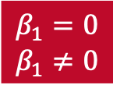
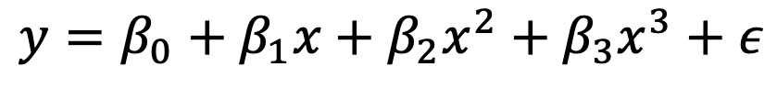
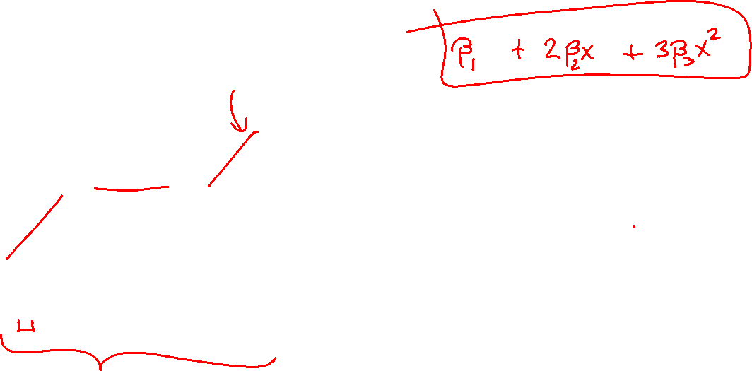
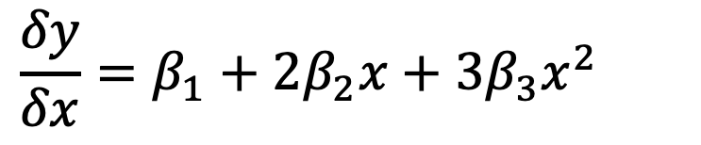
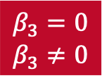
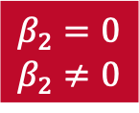
The Effect of Variable $x$ on the Response
How does $y$ change as $x$ changes
$$y=β_{0}+β_{1}x+β_{2}x^{2}+β_{3}x^{3}+ε$$
$$\frac{δy}{δx}=β_{1}+2β_{2}x+3β_{3}x^{2}$$
Hypothesis Test
Hypothesis Test
Hypothesis Test
$$β_{1}=0$$
$$β_{1}≠0$$
$$β_{2}=0$$
$$β_{2}≠0$$
$$β_{3}=0$$
$$β_{3}≠0$$

Slide 14
The Boston Housing Example
CRIM: Per capita crime rate by town ZN: Proportion of residential land zoned for lots over 25,000 sq. ft INDUS: Proportion of non-retail business acres per town CHAS: Charles River dummy variable (= 1 if tract bounds river; 0 otherwise) NOX: Nitric oxide concentration (parts per 10 million) RM: Average number of rooms per dwelling AGE: Proportion of owner-occupied units built prior to 1940 DIS: Weighted distances to five Boston employment centers RAD: Index of accessibility to radial highways TAX: Full-value property tax rate per $10,000 PTRATIO: Pupil-teacher ratio by town B: 1000(Bk — 0.63)², where Bk is the proportion of [people of African American descent] by town LSTAT: Percentage of lower status of the population MEDV: Median value of owner-occupied homes in $10000s

Slide 15
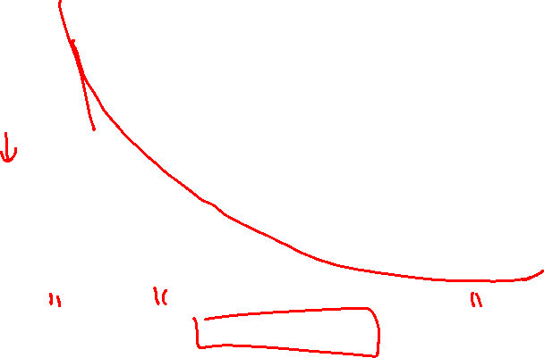
The Boston Housing Example
LSTAT: Percentage of lower status of the population MEDV: Median value of owner-occupied homes in $1000s

Slide 16
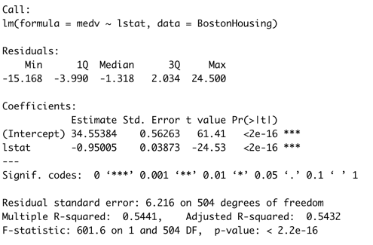

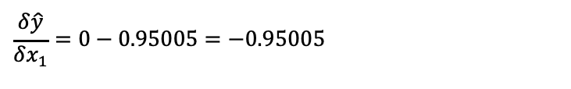
The Boston Housing Example
LSTAT: Percentage of lower status of the population MEDV: Median value of owner-occupied homes in $10000s
$$\frac{δ\hat{y}}{δx_{1}}=0−0.95005=−0.95005$$
Effect of LSTAT
As the lower status of the population increases by 1 percent, we estimate the median home value to decrease by 0.95005 (in $10000) or by $9.500

Slide 17
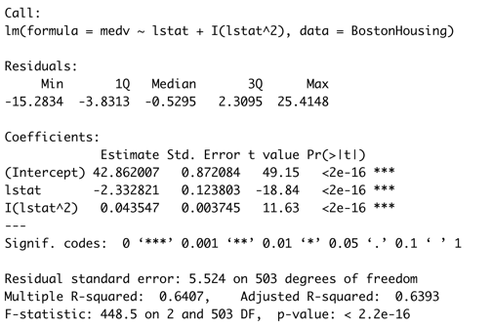
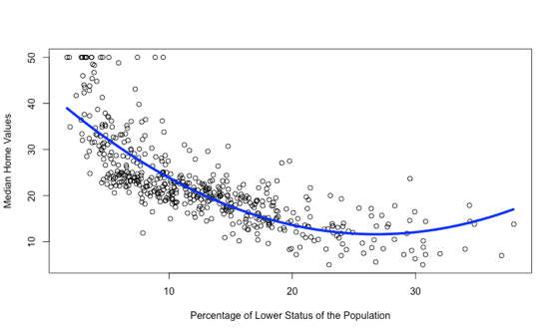
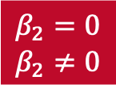

The Boston Housing Example
CRIM: Per capita crime rate by town
LSTAT: Percentage of lower status of the population MEDV: Median value of owner-occupied homes in $10000s
Hypothesis Test
$$β_{2}=0$$
$$β_{2}≠0$$
$$\frac{δ\hat{y}}{δx_{1}}=0−2.332621+0.043547x_{1}=−2.332621+2∗0.043547x_{1}$$
Effect of LSTAT
As the lower status of the population increases by 1 percent, we estimate the median home value to change by $−2.332621+2∗0.043547 lstat$. So it depends on lstat

Slide 18
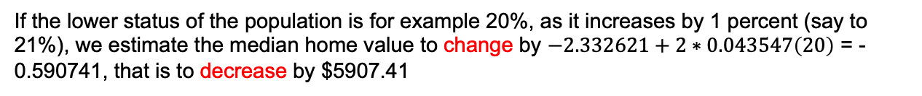
The Boston Housing Example
LSTAT: Percentage of lower status of the population MEDV: Median value of owner-occupied homes in $10000s
$$\frac{δ\hat{y}}{δx_{1}}=0−2.332621+2∗0.043547x_{1}=−2.332621+2∗0.043547x_{1}$$
Effect of LSTAT
If the lower status of the population is for example 20%, as it increases by 1 percent (say to 21%), we estimate the median home value to change by $−2.332621+2∗0.043547\left(20\right)$ = -0.590741, that is to decrease by $5907.41

Slide 19

The Boston Housing Example
LSTAT: Percentage of lower status of the population MEDV: Median value of owner-occupied homes in $10000s
$$\frac{δ\hat{y}}{δx_{1}}=0−2.332621+2∗0.043547x_{1}=−2.332621+2∗0.043547x_{1}$$
Effect of LSTAT
If the lower status of the population is for example 30%, as it increases by 1 percent (say to 31%), we estimate the median home value to change by $−2.332621+2∗0.043547\left(30\right)$ = 0.280199, that is to increase by $2801.99

Slide 20
The Boston Housing Example
LSTAT: Percentage of lower status of the population MEDV: Median value of owner-occupied homes in $10000s
$$\frac{δ\hat{y}}{δx_{1}}=0−2.332621+2∗0.043547x_{1}=−2.332621+2∗0.043547x_{1}$$
Effect of LSTAT
If the lower status of the population is for example 30%, as it increases by 1 percent (say to 31%), we estimate the median home value to change by $−2.332621+2∗0.043547\left(30\right)$ = 0.280199, that is to increase by $2801.99

Slide 21
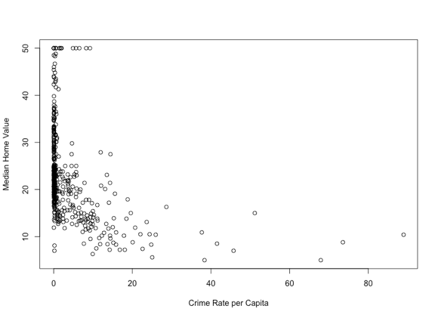
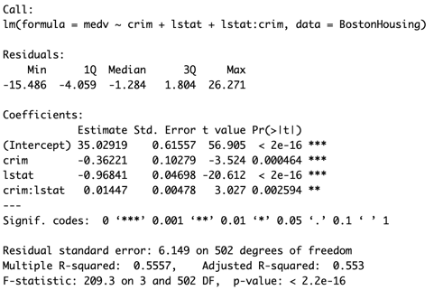
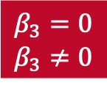
The Boston Housing Example
CRIM: Per capita crime rate by town
LSTAT: Percentage of lower status of the population MEDV: Median value of owner-occupied homes in $10000s
Hypothesis Test
$$β_{3}=0$$
$$β_{3}≠0$$
$$\frac{δ\hat{y}}{δx_{1}}=0−0.36221+0.01447x_{2}=−0.36221+0.01447x_{2}$$
Effect of CRIM
As the crime per capita increases by 1, we estimate the median home value to change by$−0.36221+0.01447lstat$. So it depends on lstat

Slide 22
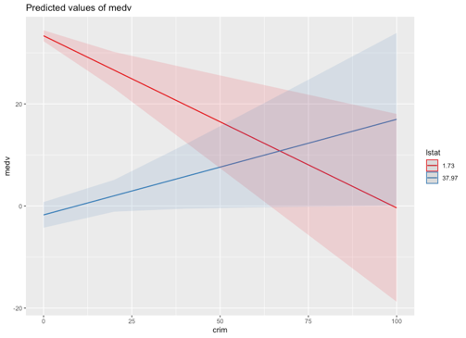

The Boston Housing Example
CRIM: Per capita crime rate by town
LSTAT: Percentage of lower status of the population MEDV: Median value of owner-occupied homes in $10000s
Hypothesis Test
$$β_{3}=0$$
$$β_{3}≠0$$
$$\frac{δ\hat{y}}{δx_{1}}=0−0.36221+0.01447x_{2}=−0.36221+0.01447x_{2}$$
Effect of CRIM
As the crime per capita increases by 1, we estimate the median home value to change by$−0.36221+0.01447lstat$. So it depends on lstat

Slide 23
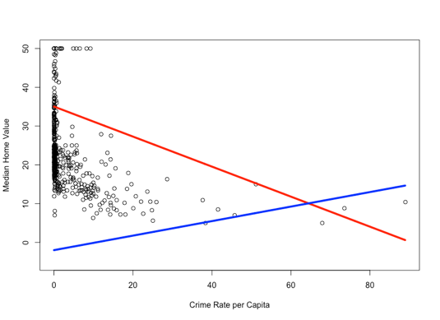
The Boston Housing Example
CRIM: Per capita crime rate by town
LSTAT: Percentage of lower status of the population MEDV: Median value of owner-occupied homes in $10000s
Hypothesis Test
$$β_{3}=0$$
$$β_{3}≠0$$
$$\frac{δ\hat{y}}{δx_{1}}=0−0.36221+0.01447x_{2}=−0.36221+0.01447x_{2}$$
Effect of CRIM
As the crime per capita increases by 1, we estimate the median home value to change by$−0.36221+0.01447lstat$. So it depends on lstat

Slide 24
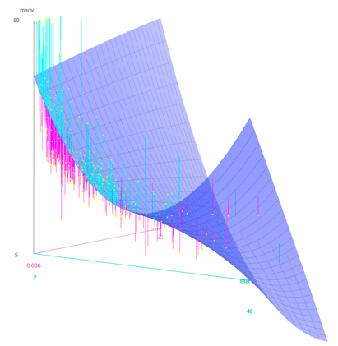
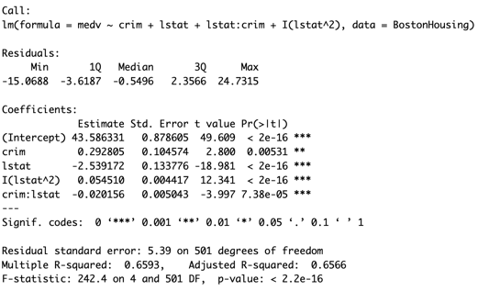
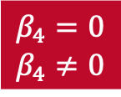

The Boston Housing Example
CRIM: Per capita crime rate by town
LSTAT: Percentage of lower status of the population MEDV: Median value of owner-occupied homes in $10000s
Hypothesis Test
$$β_{4}=0$$
$$β_{4}≠0$$
$$\frac{δ\hat{y}}{δx_{1}}=0−0.292805−0.020156x_{2}=0.292805−0.020156x_{2}$$
Effect of CRIM
As the crime per capita increases by 1, we estimate the median home value to change by $0.292805−0.020156lstat$. So it depends on lstat

Slide 25
The Boston Housing Example
CRIM: Per capita crime rate by town
LSTAT: Percentage of lower status of the population MEDV: Median value of owner-occupied homes in $10000s
Hypothesis Test
$$β_{4}=0$$
$$β_{4}≠0$$
$$\frac{δ\hat{y}}{δx_{2}}=0−2.539172+2∗0.054510x_{2}−0.020156x_{1}=−2.539172+2∗0.054510x_{2}−0.020156x_{1}$$
Effect of LSTAT
As the lower status of the population increases by 1 percent, we estimate the median home value to change by $−2.539172+2∗0.054510lstat−0.020156crim$. So it depends on lstat and crim

Slide 26

Practice

